Slide 1
Multimedia in preschool an additional opportunity towards equal Opportunities in education Chris Mazarese¹, Nele Vanuytven¹, Greet Decin¹, Evelien Buyse² ¹KHLeuven, Department of Teacher Training (Belgium) ²KULeuven, Faculty of Psychology and Educational Sciences (Belgium)

Slide 2
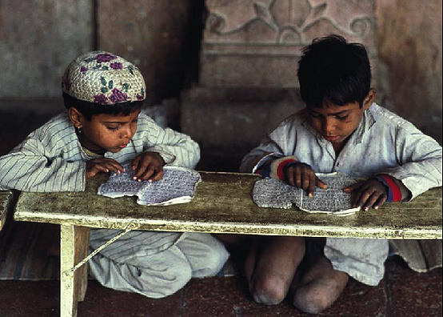
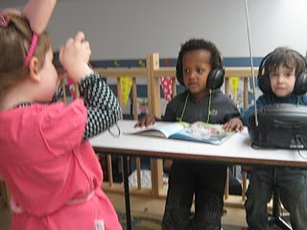
Multimedia as a means of communication for children
Language literacy
Multimedia rich society
Multimedia literacy a task for education in preschool

Slide 3
Practice-based project
Objectives
Can we stimulate multimedia literacy of preschool children (3 to 5 year olds)?
Does the use of multimedia influence their discovery of the world? (eight specific skills)
Do multimedia offer extra chances for children with extra needs?
Can we reduce technological fear?
Participants
Teacher-trainers – student teachers – class teachers
Time frame
3 years

Slide 4
Critical media setting
Cross case observation
Observation Instruments
RESEARCH
First try-outs
Focus: audio visual learning
Good practices

Slide 5
EXPERTS IN SOUNDS
ZEN MOMENT FOCUS SOUND

Slide 6
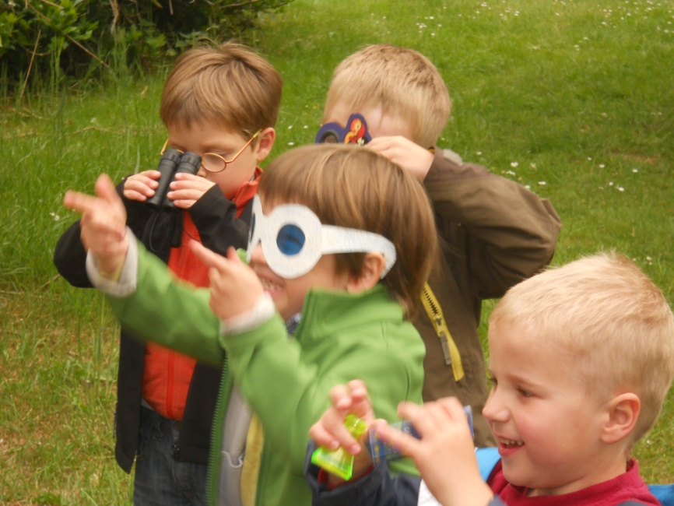
OPTIMIZING VIEWING SKILLS
COMMUNICATION AND EXPRESSION

Slide 7
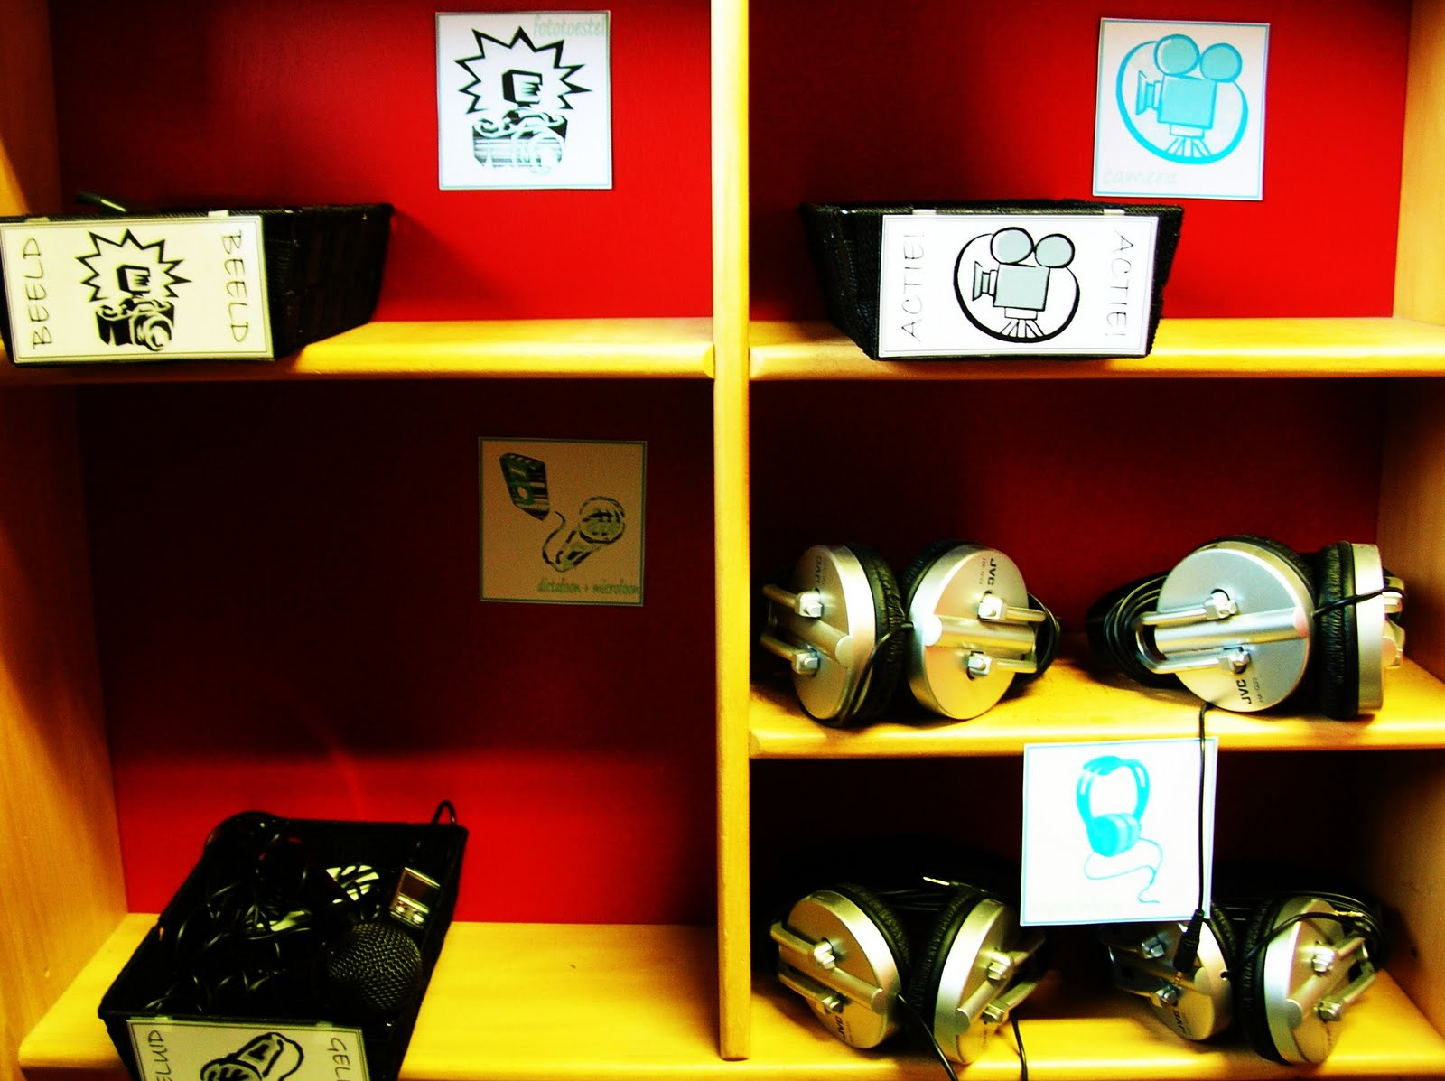
Critical Media Setting
Camera
Video
camera
Dictaphones and
microfones
Headphones

Slide 8
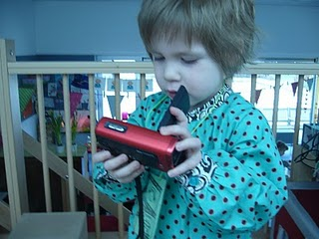
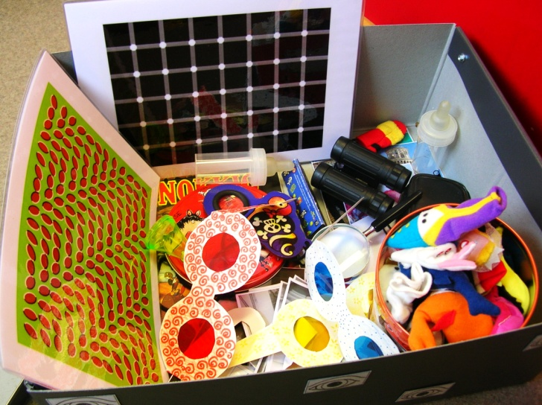
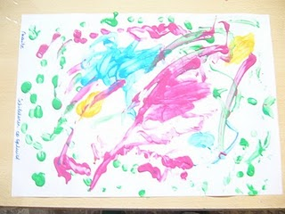
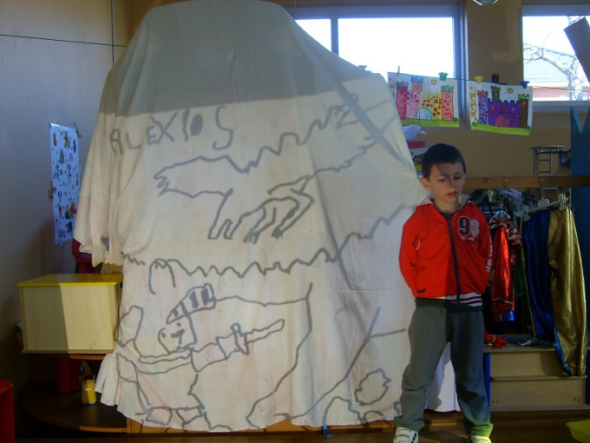
- extra activities -
Camera-man of the day
Discovering sounds and images with all kinds of material
Painting sounds
Discovering visuals with overhead projections

Slide 9
First Try-Outs
Multimedia-rich activities
A group of children with extra needs
Development and try-out of the observation framework
First indications
New Questions

Slide 10
Step 1 | Step 2 | Step 3 |  | Step 4 | Step 5
TRF and CBCL | Pre-measurement using protocols | Intervention using cross design |  | Short-term observation using protocols | Long-term observation using protocols
 | These measurements are analyzed using qualitative observation lists | Condition 1 Without extra teacher Without audiovisual input | Condition 2 Without extra teacher With audiovisual input | These measurements are analyzed using qualitative observation lists, TRF and CBCL | These measurements are analyzed using qualitative observation lists, TRF and CBCL
 |  | Condition 3 With extra teacher Without audiovisual input | Condition 4 With extra teacher With audiovisual input
 |  | In each condition we follow: - 8 children of 3 years old: 5 with extra needs and 3 control - 8 children of 5 years old: 5 with extra needs and 3 control (children with extra needs are selected in step 1) Holistic video analysis will be used to score wellbeing, involvement, ... during activities

Slide 11
Observation Frame

Slide 12
Listening-interaction-expression

Slide 13
Questions?

